Slide 1
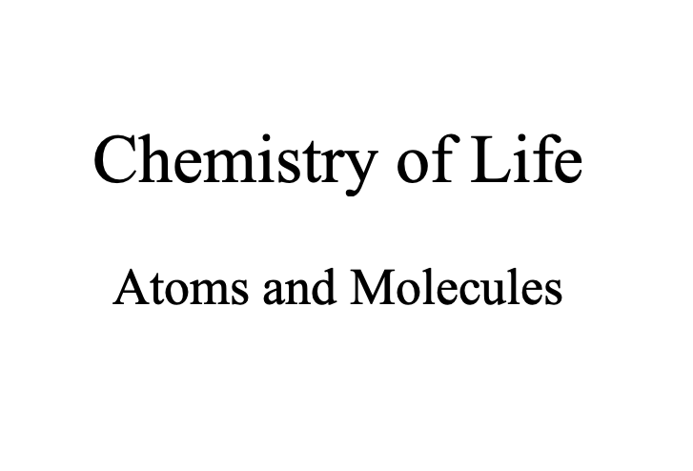

Slide 2
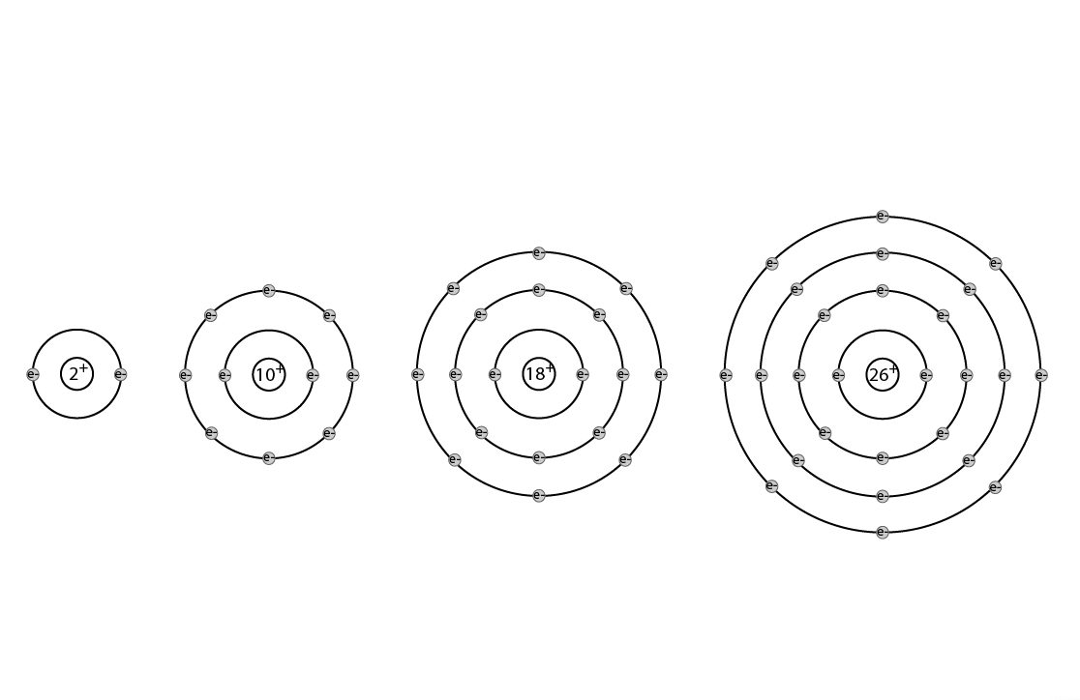

Slide 3
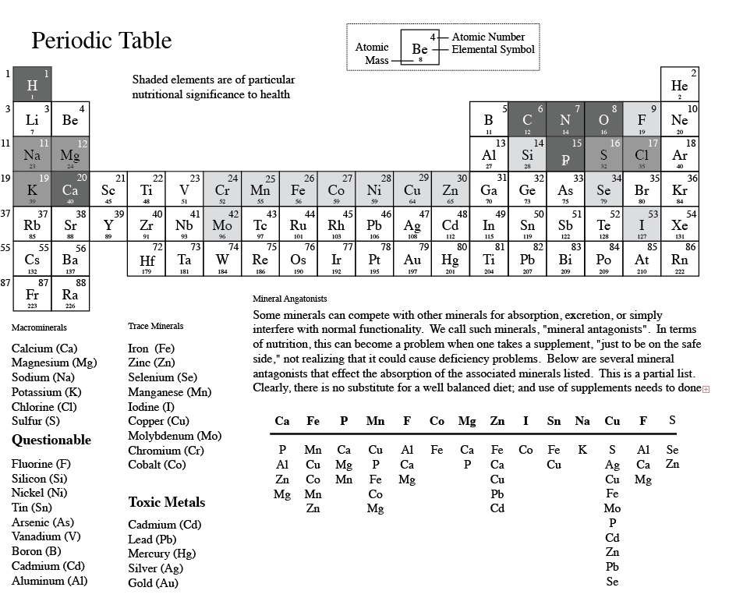

Slide 4
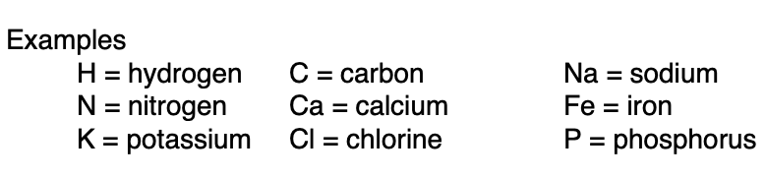

Slide 5
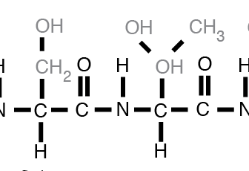
Organic vs Inorganic Compounds

Slide 7
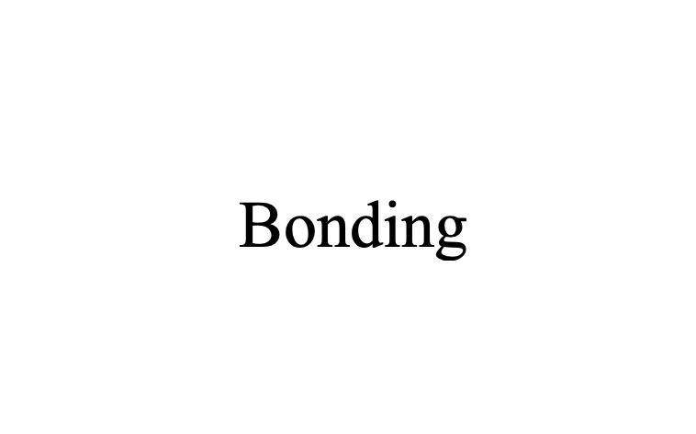

Slide 8
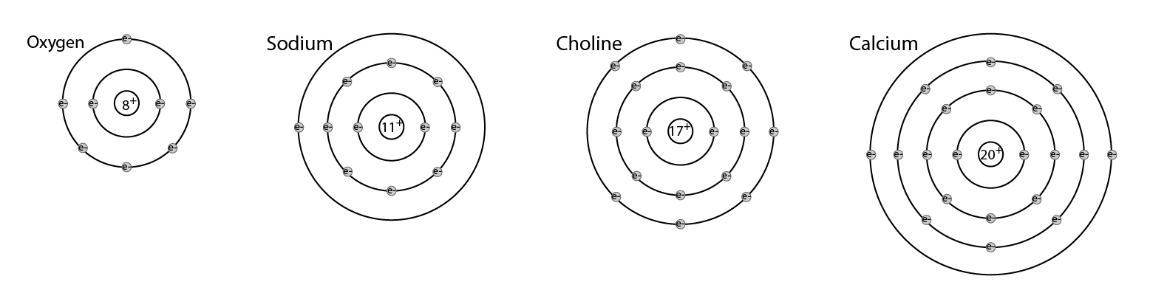

Slide 10
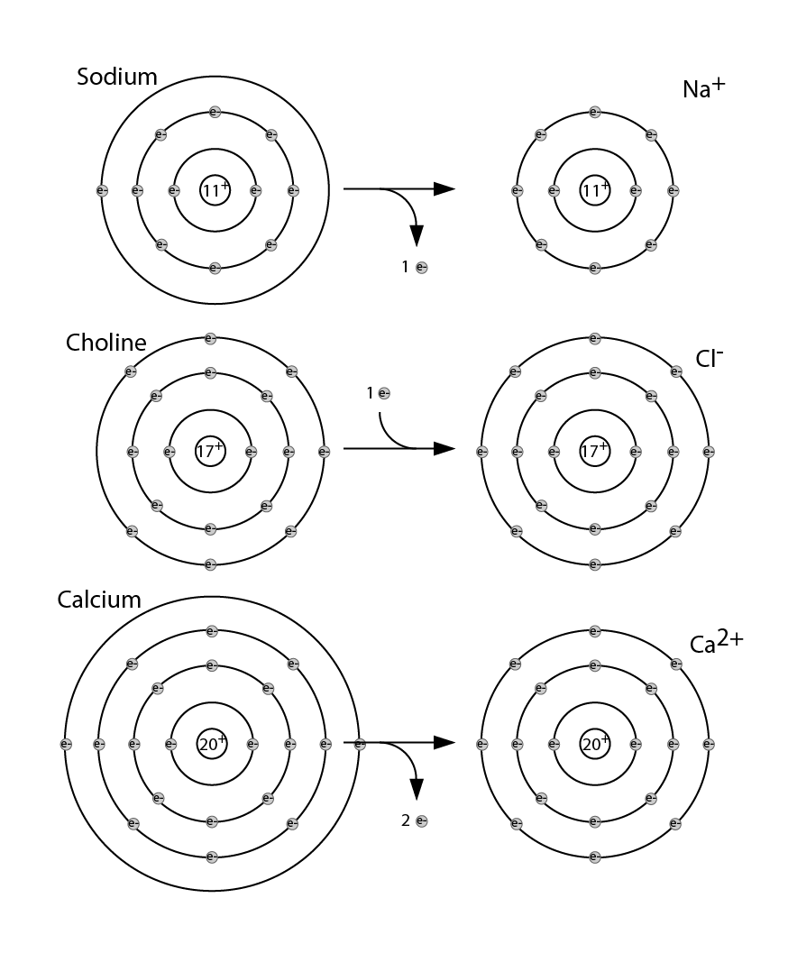

Slide 11
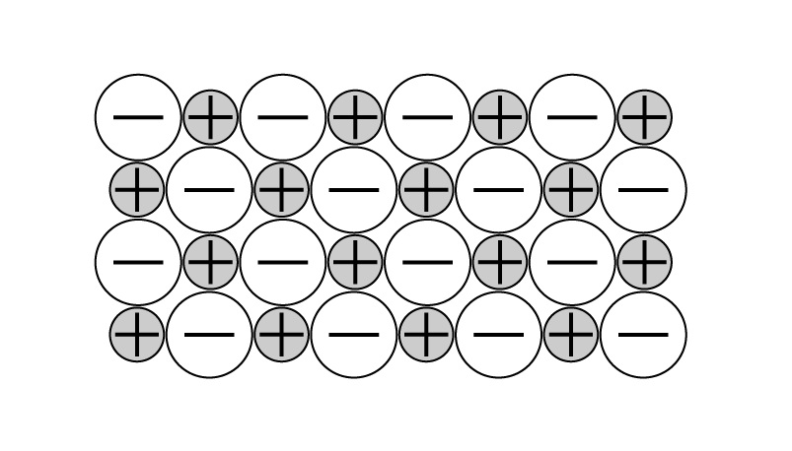

Slide 13
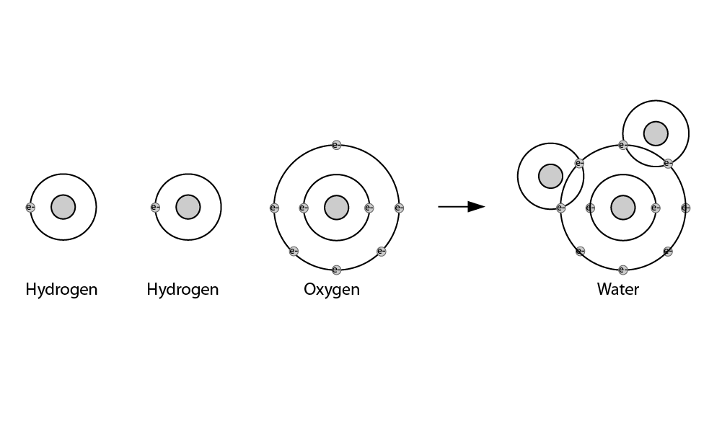

Slide 14
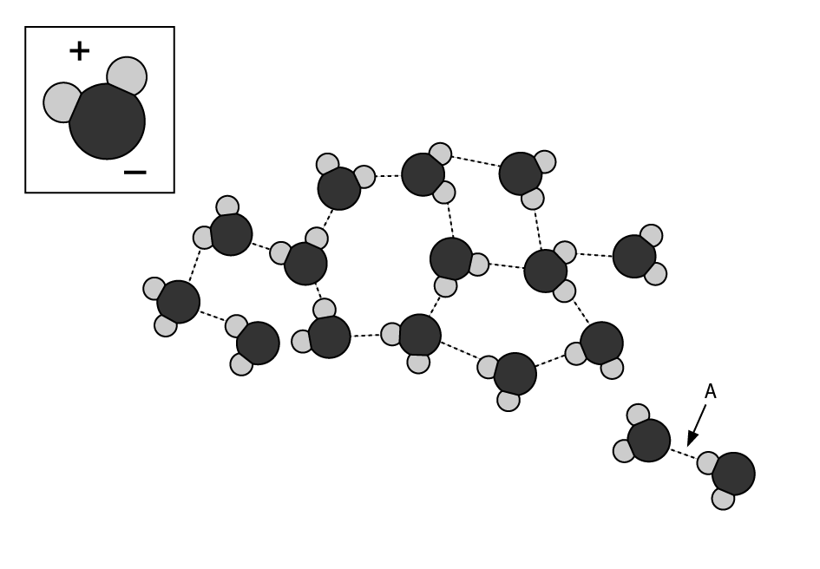

Slide 16
Chemical Reactions

Slide 17
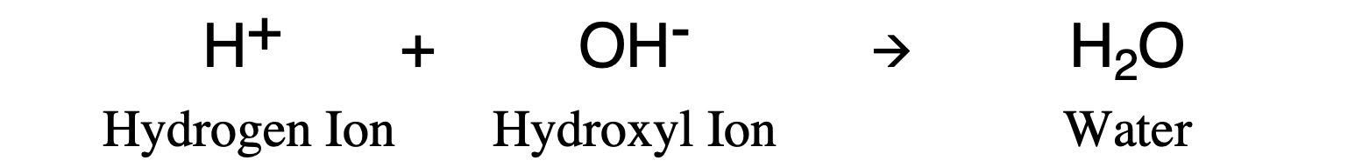

Slide 18
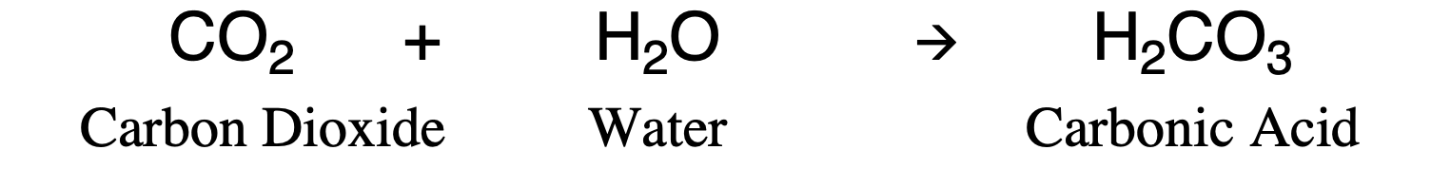

Slide 19
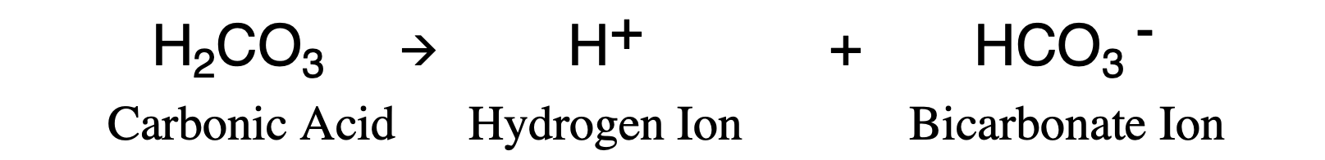

Slide 21
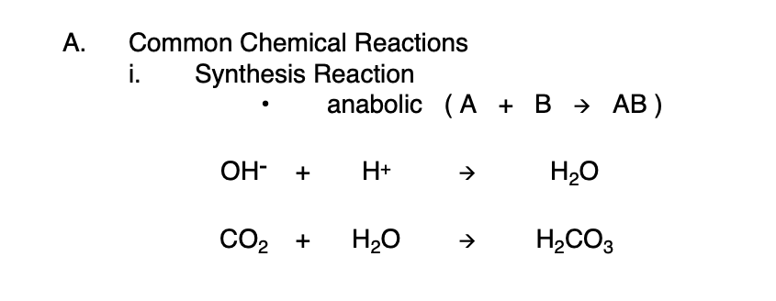

Slide 22
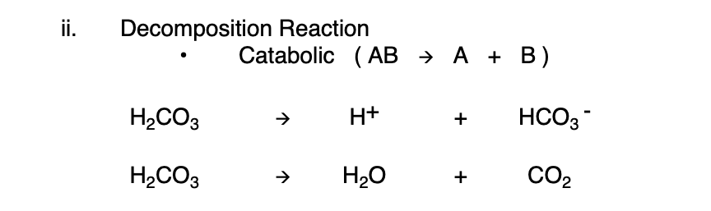

Slide 25
Oxidation-Reduction Reactions
( Or, Redox Reactions )

Slide 26
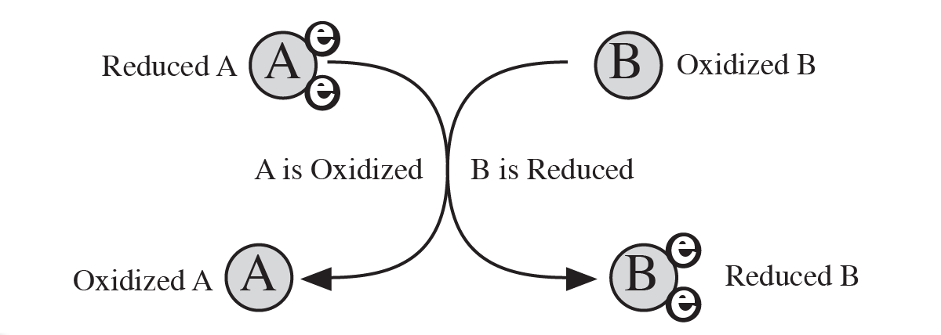

Slide 27
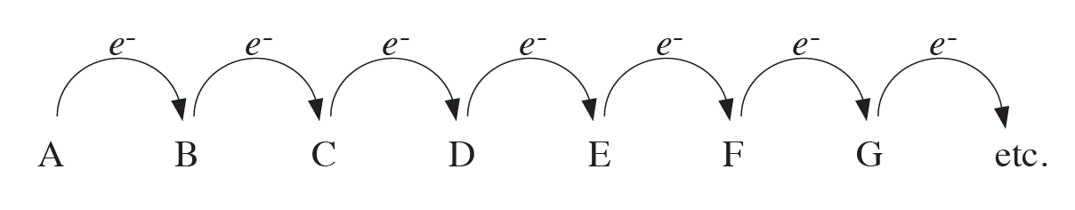

Slide 29
Chain Reactions

Slide 30
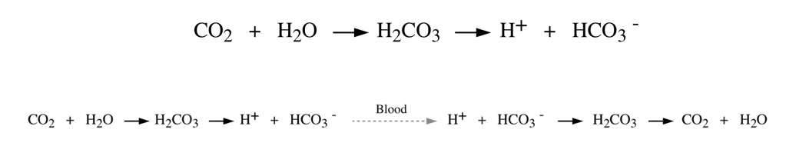

Slide 33
Reversibility of Reactions

Slide 34
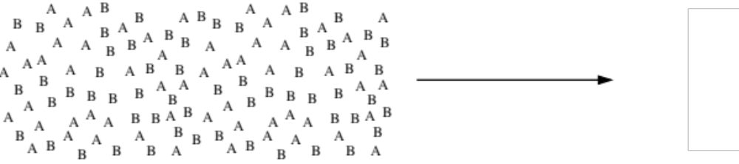

Slide 35
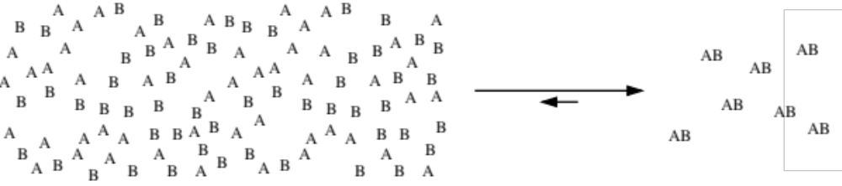

Slide 36
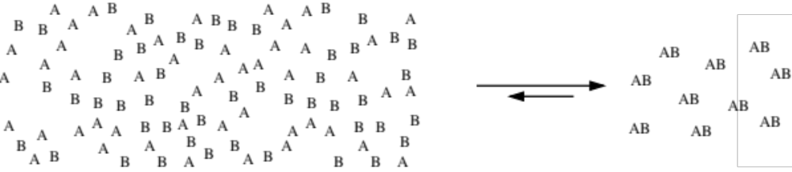

Slide 37
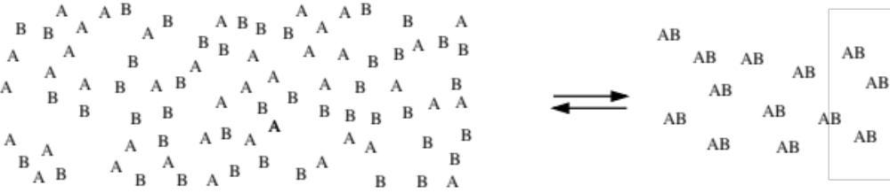

Slide 38
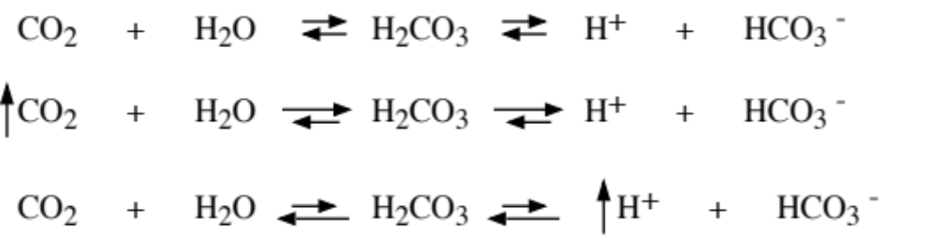

Slide 39
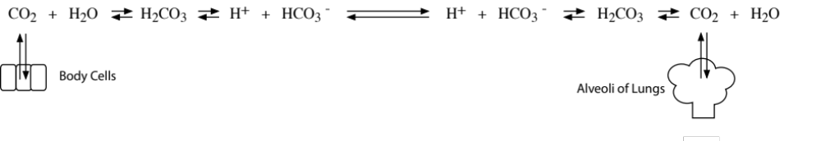

Slide 40
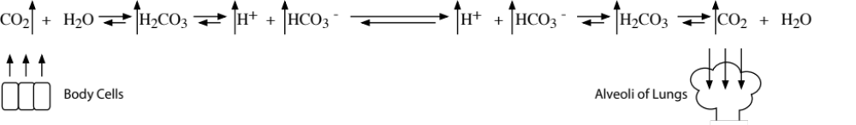

Slide 42
Reaction Rate

Slide 43
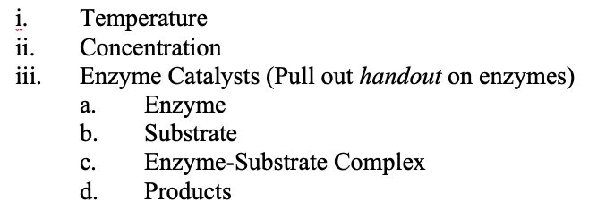

Slide 45
Enzymes

Slide 46
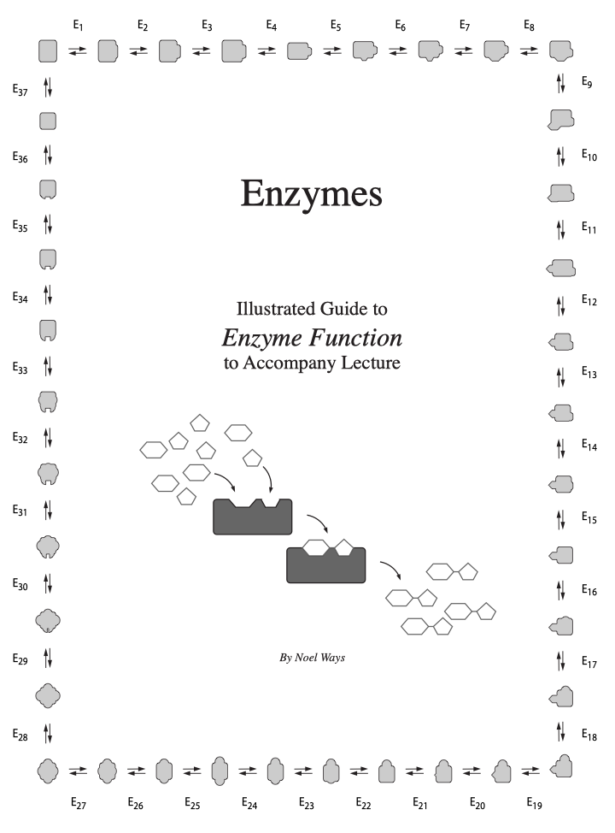

Slide 47
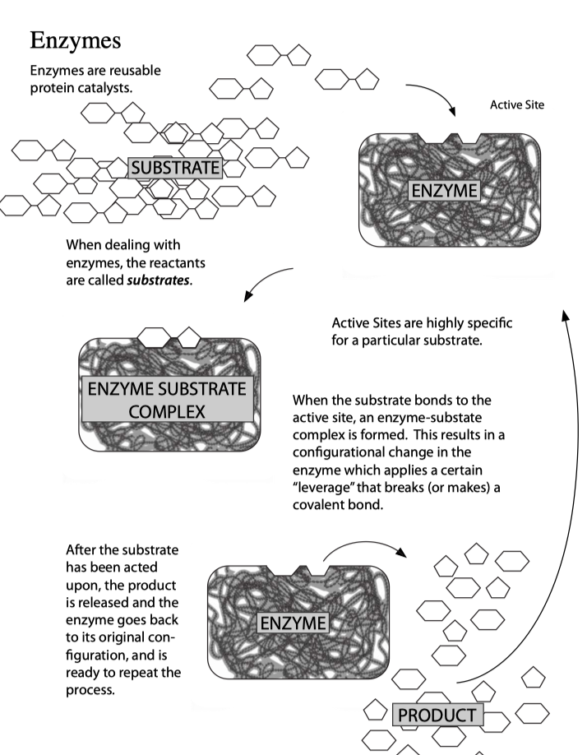

Slide 48
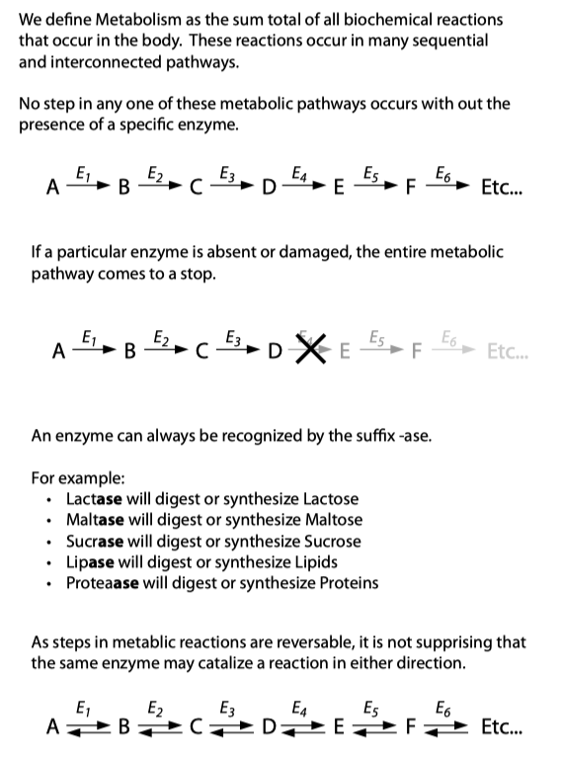

Slide 52
Inorganic Compounds
(Water)

Slide 54
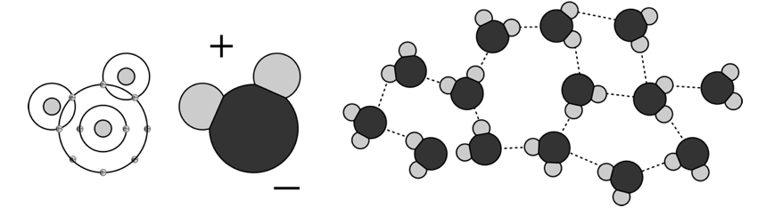

Slide 58
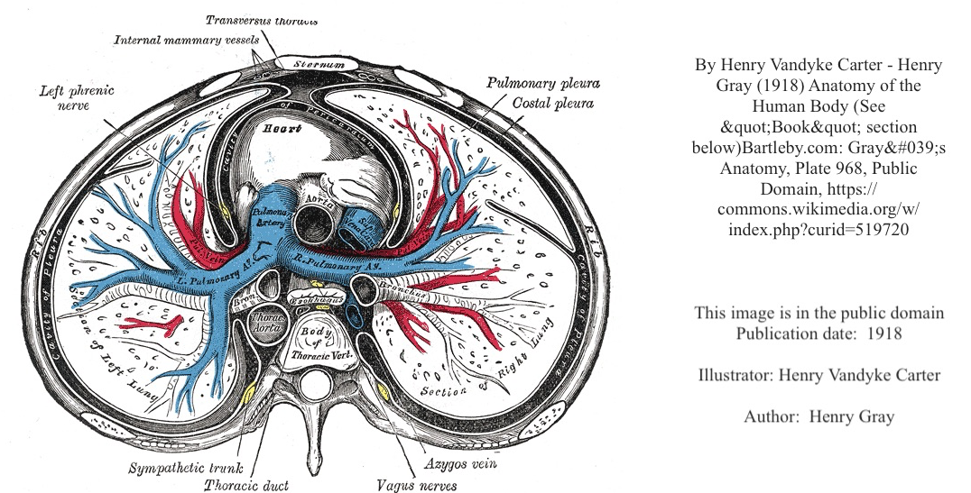

Slide 60
Inorganic Compounds
(Salts)

Slide 63
Acids and Bases

Slide 65
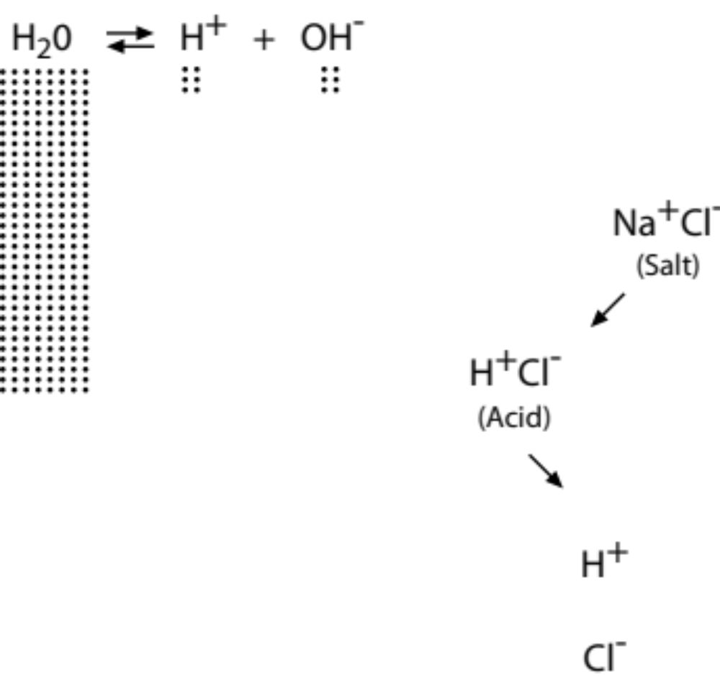

Slide 66
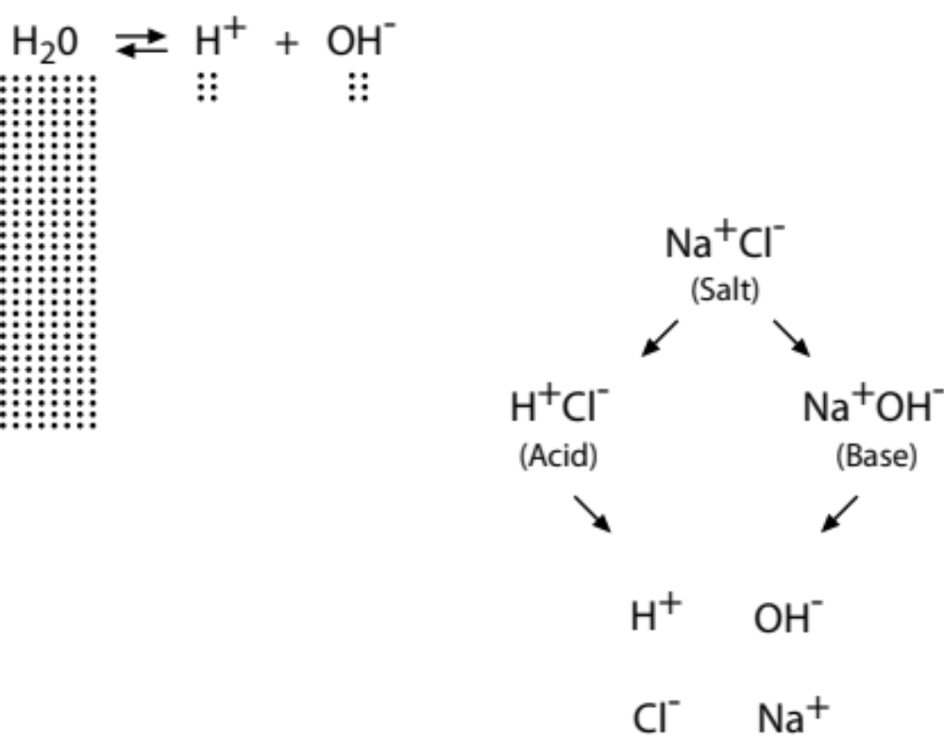

Slide 67
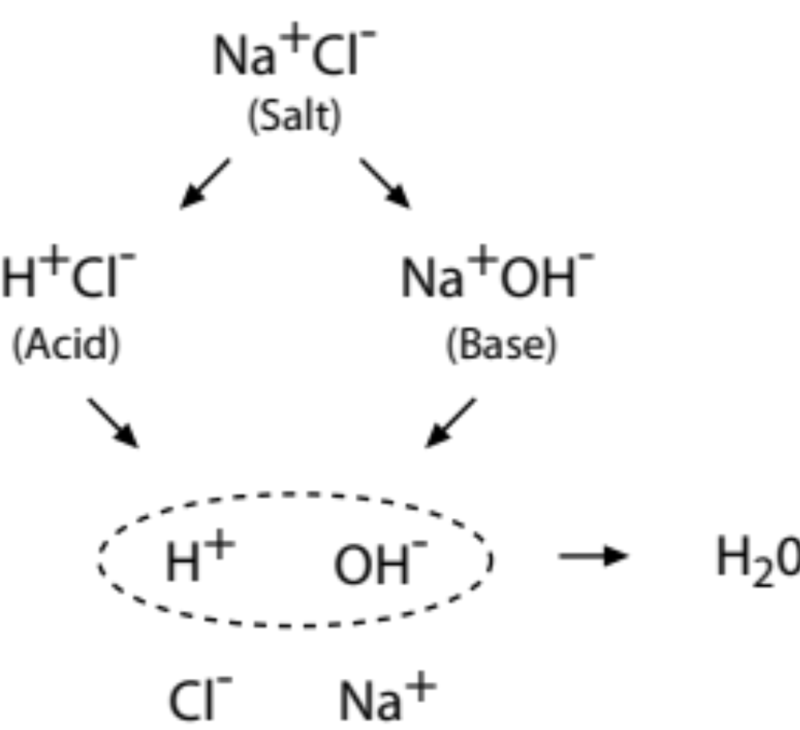

Slide 68
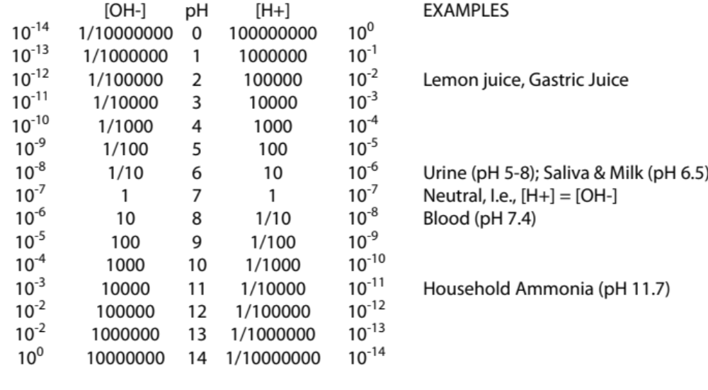

Slide 69
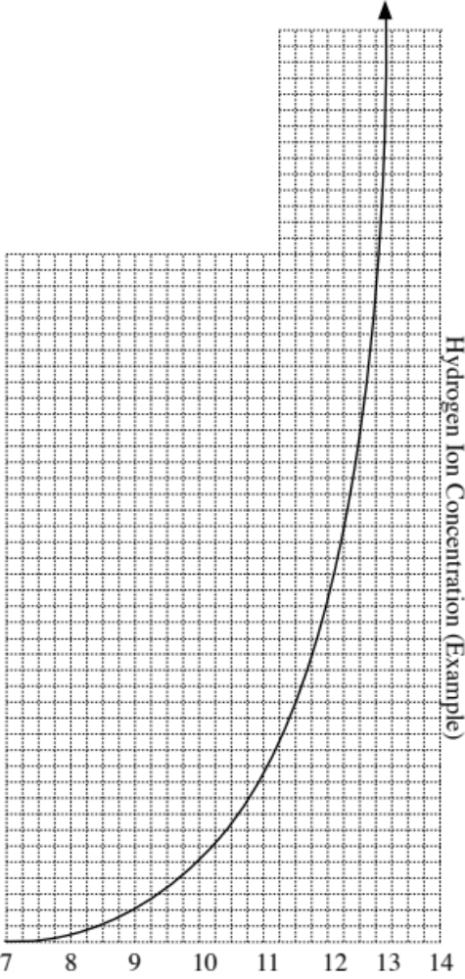

Slide 71
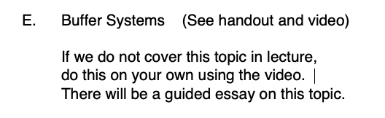

Slide 73
Organic Compounds

Slide 75
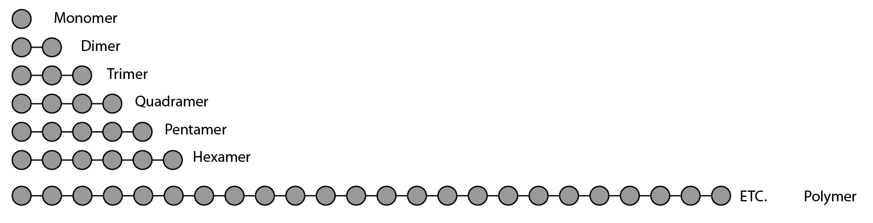

Slide 77
Carbohydrates

Slide 78
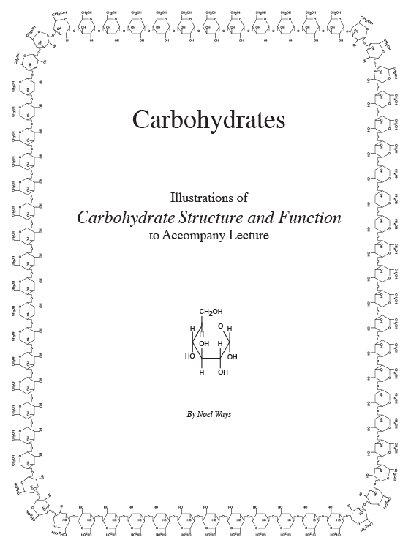
Have this handout in hand at this time

Slide 79
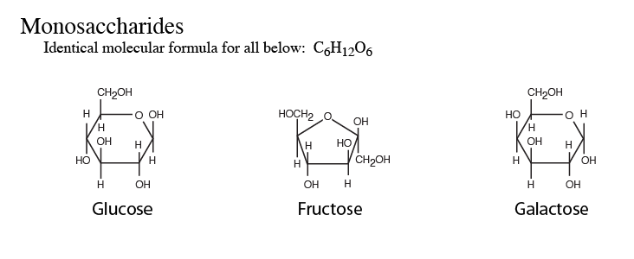

Slide 80
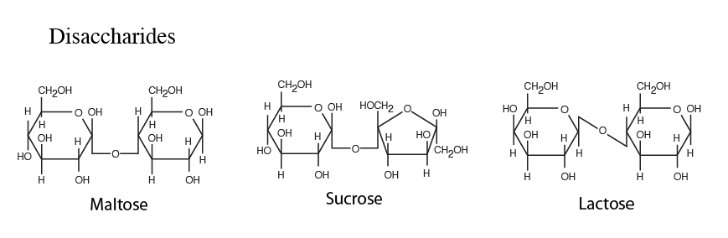

Slide 81
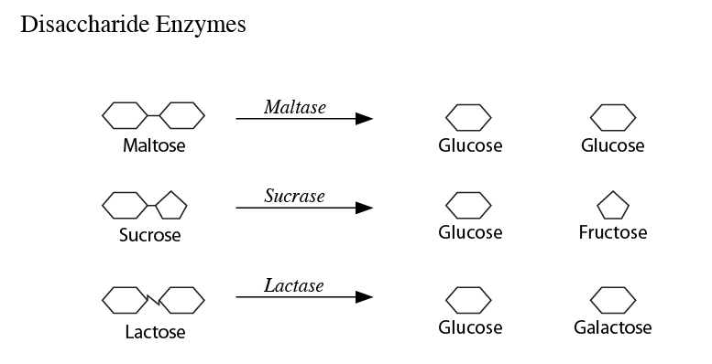

Slide 82
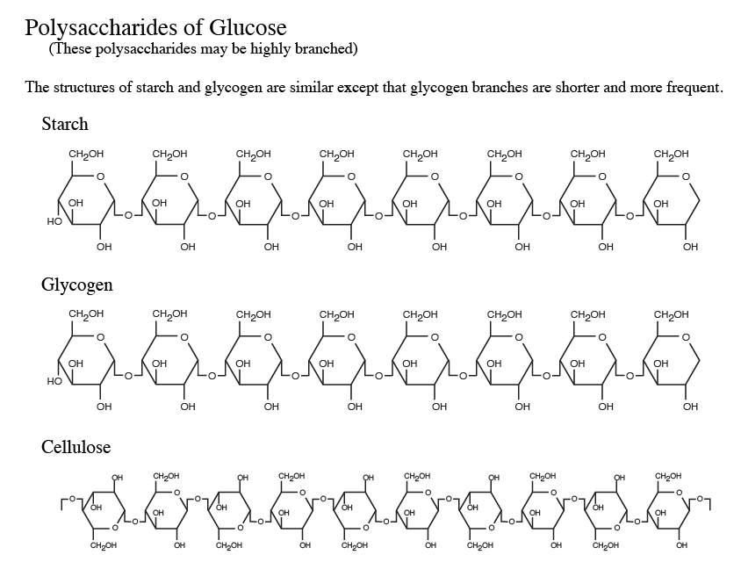

Slide 83
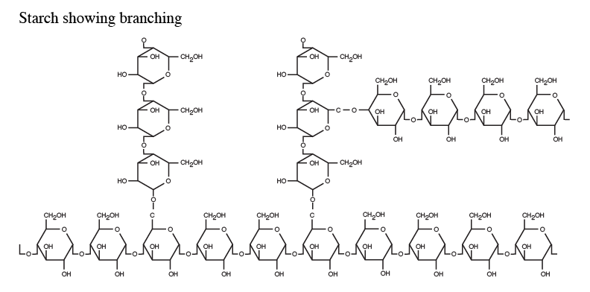

Slide 85
Energetics

Slide 86


Slide 87
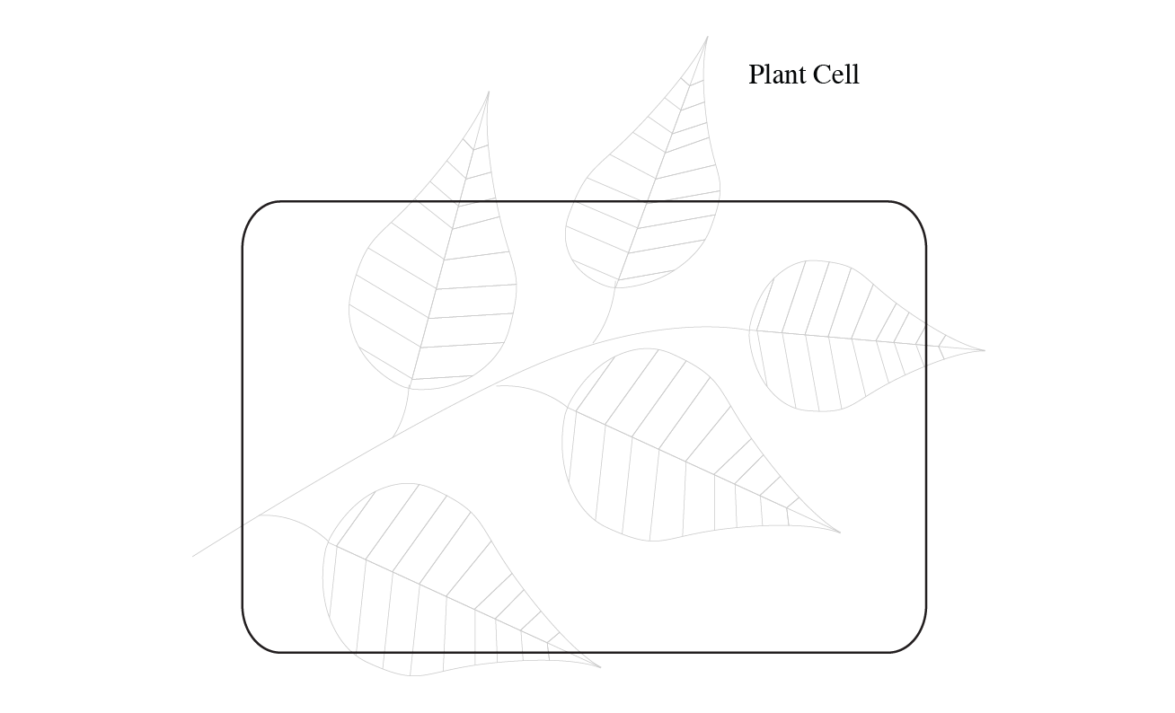

Slide 88
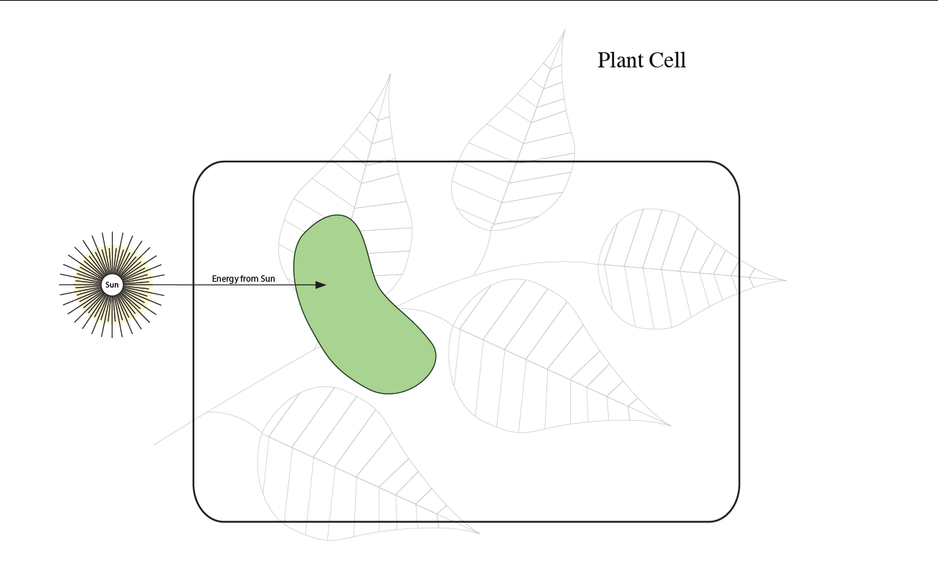

Slide 89
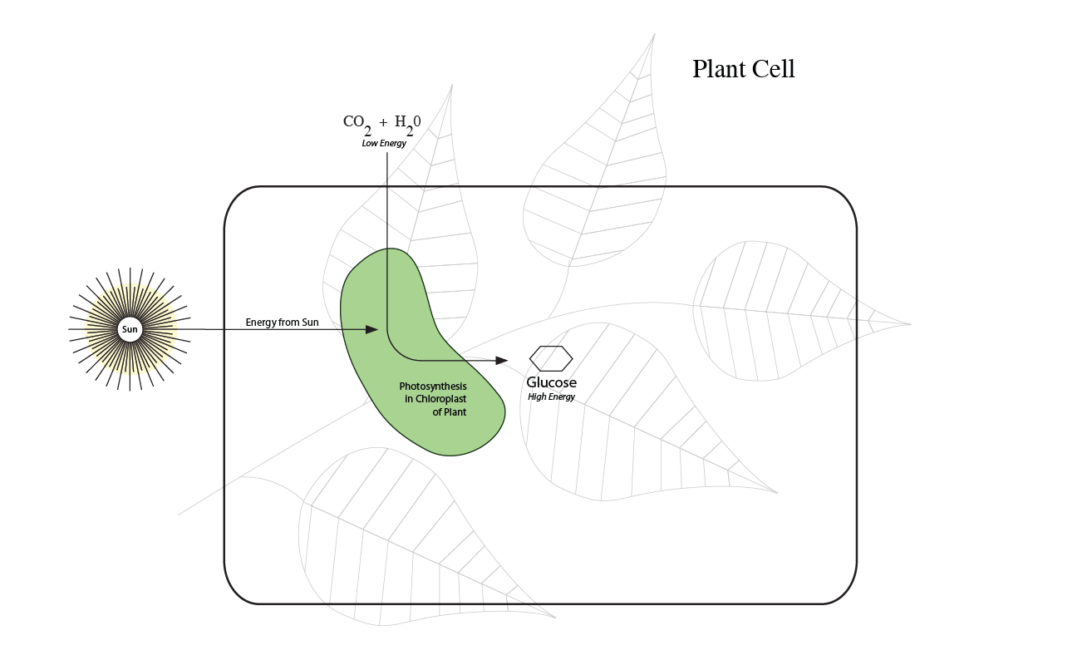

Slide 90
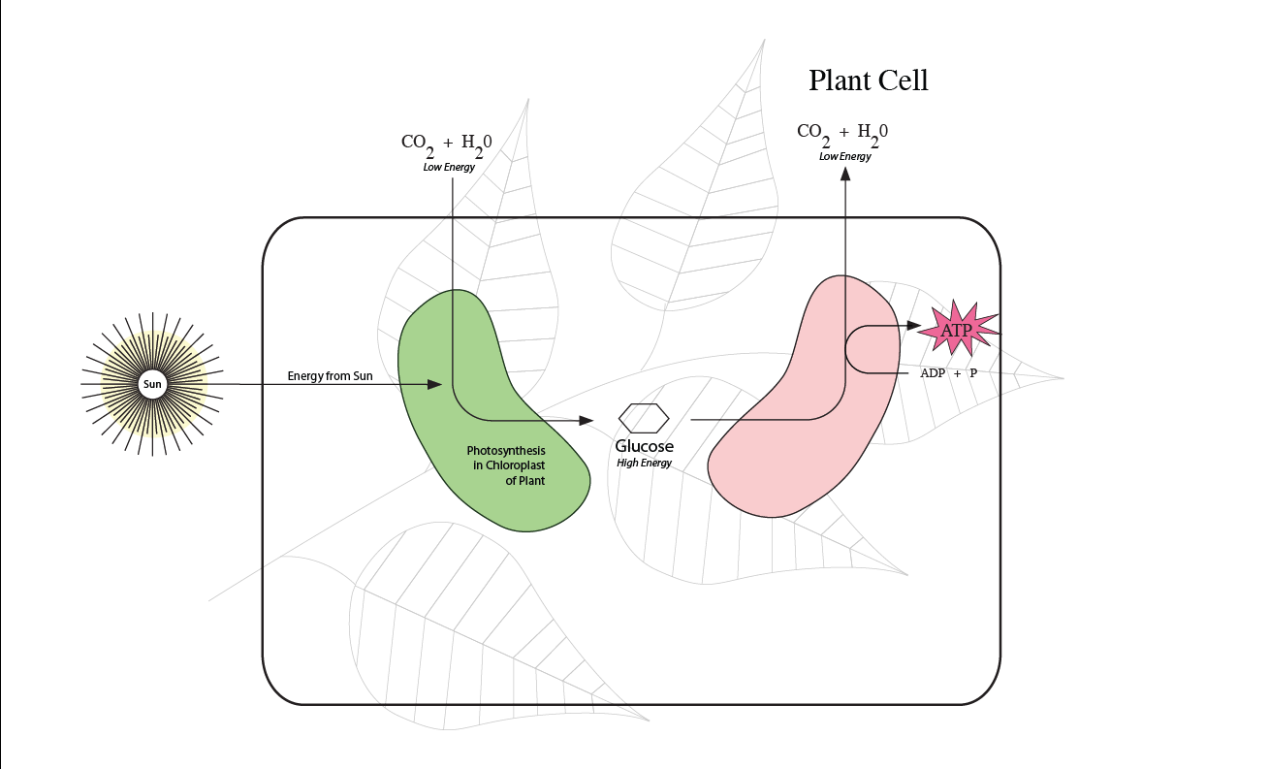

Slide 91
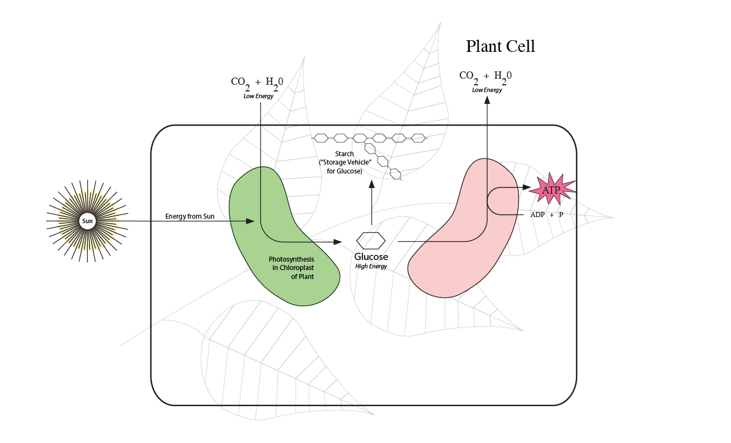

Slide 92


Slide 93


Slide 95


Slide 96


Slide 97


Slide 98


Slide 99


Slide 100


Slide 102
Lipids

Slide 103




Slide 105



Slide 107


Slide 108


Slide 109


Slide 111
Lipids
and Emulsification

Slide 112


Slide 113


Slide 114


Slide 115


Slide 116


Slide 117


Slide 119


Slide 121
Protein
(Structure)

Slide 122


Slide 123


Slide 124


Slide 125


Slide 126


Slide 127


Slide 128


Slide 130
Protein
(Denaturation)

Slide 131


Slide 132


Slide 133


Slide 134


Slide 135


Slide 136


